Slide 1
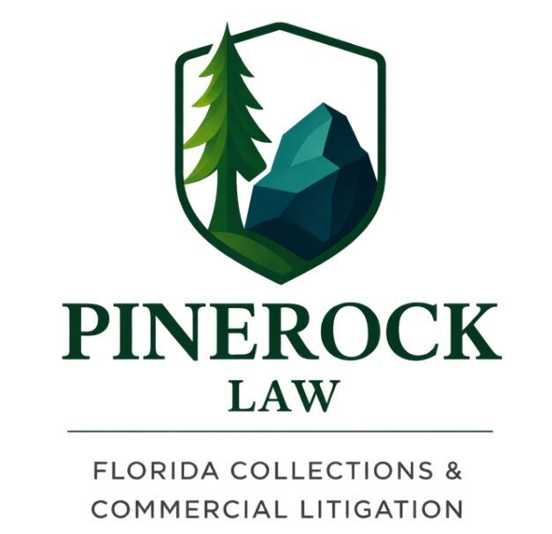
Florida Debt Collection Attorney for Commercial & Judgment Recovery

Slide 2

Debt Collection Lawyer Florida
PineRock Law provides strategic debt recovery services for businesses across Florida. Our experienced attorneys handle negotiations, demand letters, and litigation with a results-focused approach. We work efficiently to recover outstanding debts while protecting your business relationships and legal interests.

Slide 3

Debt Collection Services
Our team manages commercial and business debt collection with professionalism. We communicate with debtors, prepare legal notices, negotiate settlements, and pursue court action when necessary. Every case is handled with attention to detail and compliance with Florida law.

Slide 4

Demand Letters & Negotiation
A professionally drafted demand letter often resolves disputes before litigation. We represent clients during negotiations to maximize recovery while minimizing legal costs. Our attorneys focus on practical solutions that save both time and resources.

Slide 5
Litigation Support
When negotiations fail, our litigation team is prepared to represent your interests in court. We build strong legal strategies, gather evidence, file claims, and advocate for favorable outcomes. Our goal is efficient and effective debt recovery.

Slide 6
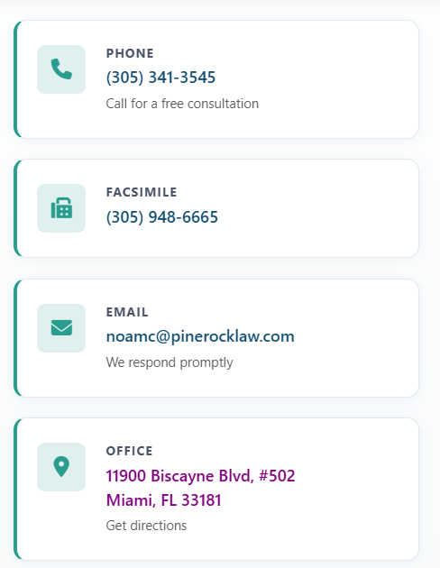
Contact PineRock Law
Partner with a trusted Florida debt collection law firm for reliable legal support. Whether you need demand letters, negotiations, or courtroom representation, we are ready to help. Contact us today to discuss your case and begin the recovery process.

